Slide 1


Model-based
Software Product Lines
Overview and Principles
Mathieu Acher
Maître de Conférences
mathieu.acher@irisa.fr

Slide 2
Material
http://mathieuacher.com/teaching/MDE/

Slide 3
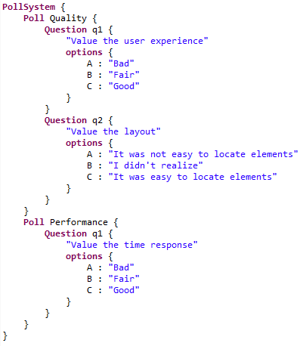
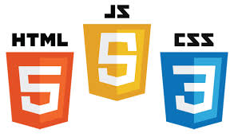


TP3
Model-to-Model
Pivot
MM
Another DSL
TP3
TP4
UI
model
Questionnaire.xtext
Model-to-Text
TP2
Generator
TP5

Slide 4
Plan
Challenges and Overview
  Developping billions of software product is hard but now a common practice
Implementing Variability
  Revisit of existing techniques and curriculum
Specificity of Product Line Engineering
  Process, methods
Feature Models
  Defacto standard for modeling product lines and variability

Slide 5
Contract
The idea of software product lines and variability
  You will be able to recognize this class of systems
  Aware of the complexity
  Aware of the specific development process
  Aware of existing techniques
Feature modeling
  A widely used formalism for modeling product lines and configurable systems in a broad sense

Slide 6
Software Product Line and
Variability Engineering
Challenges and Overview

Slide 7
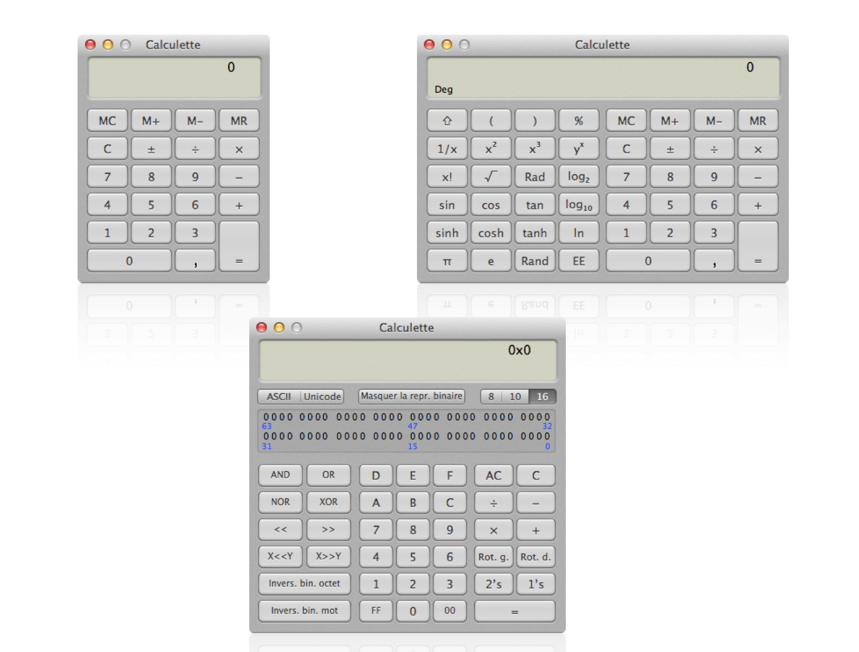

Slide 8

« A set of programs is considered to constitute a family, whenever it is worthwhile to study programs from the set by first studying the common properties of the set and then determining the special properties of the individual family members »
David L. Parnas — ‘‘On the design and development of program families’’ in Transactions on Software Engineering, SE-2(1):1–9, 1976
aka Variability

Slide 9
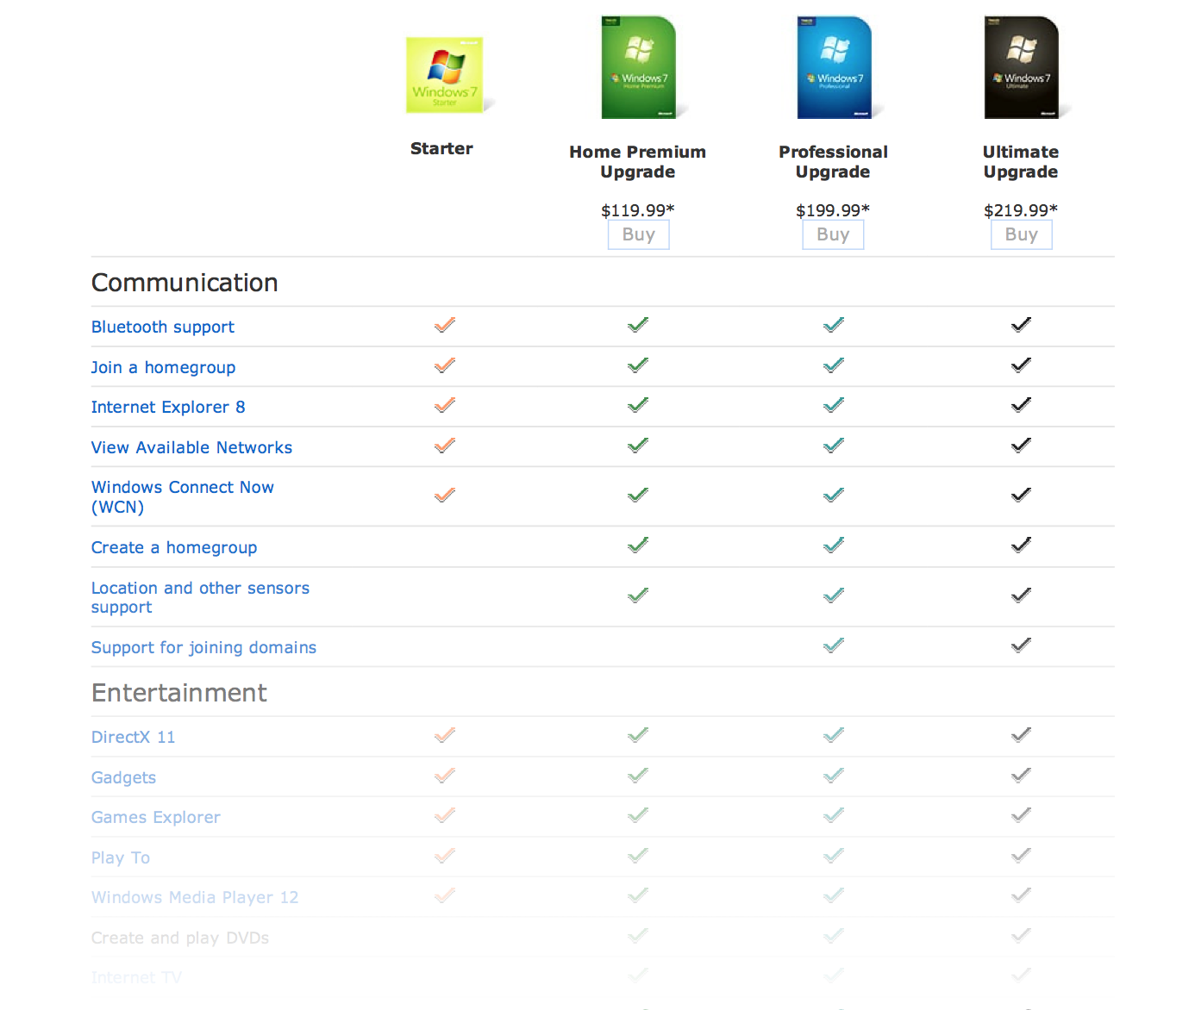

Slide 10
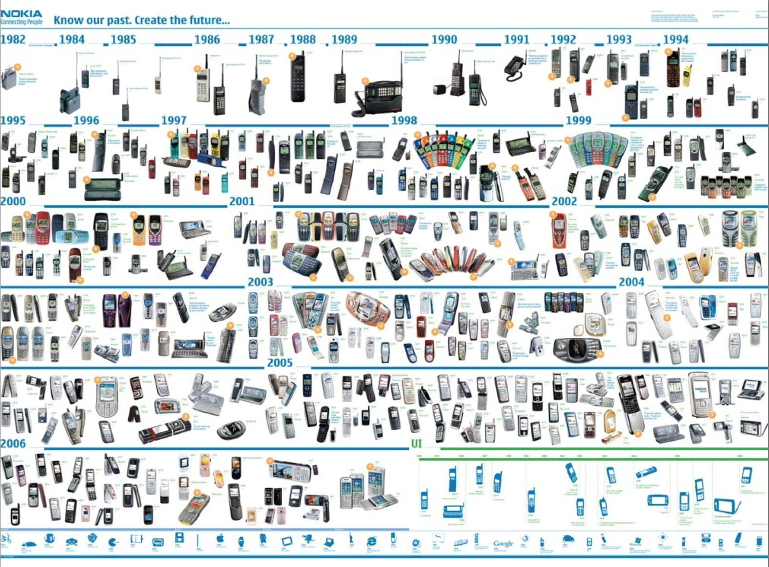

Slide 11
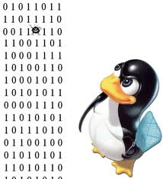
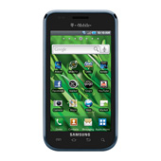

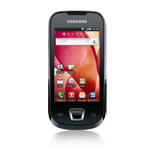

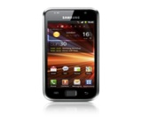
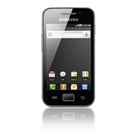
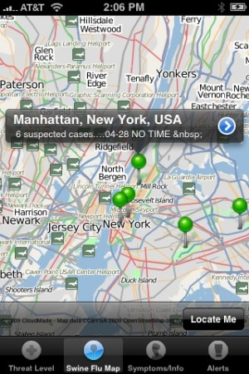

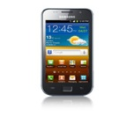

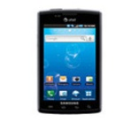

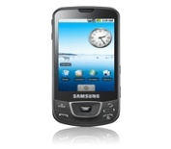
Software-intensive systems
come in many variants
Notes:
Basée sur les modèles?

Slide 12
Software Product Line Engineering
Factoring out commonalities
for Reuse [Krueger et al., 1992] [Jacobson et al., 1997]
Managing variabilities
for Software Mass Customization [Bass et al., 1998] [Krueger et al., 2001], [Pohl et al., 2005]
Notes:
By analogy with the product lines of automotive industry, there are software product lines
TODO: change the pictures (VS + Medical imaging domain)
State that “mobile phone” is just an example
Software systems.

Slide 13
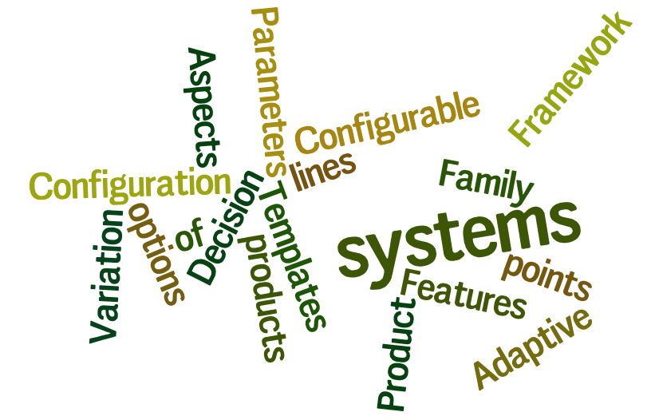
Variability
“the ability of a system to be efficiently extended, changed, customized or configured for use in a particular context”
Mikael Svahnberg, Jilles van Gurp, and Jan Bosch (2005)

Slide 14
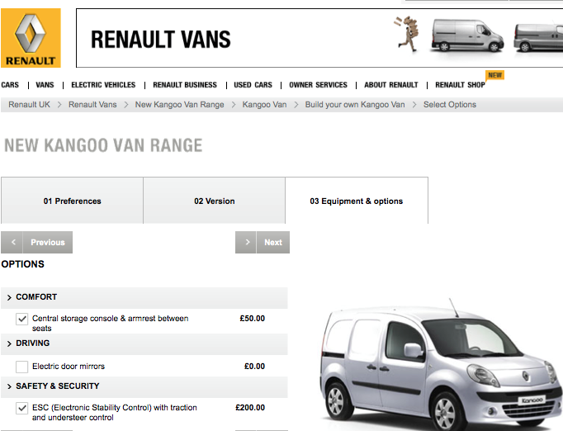
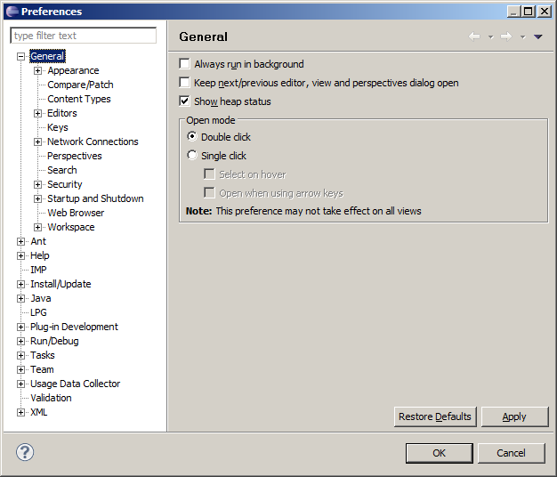
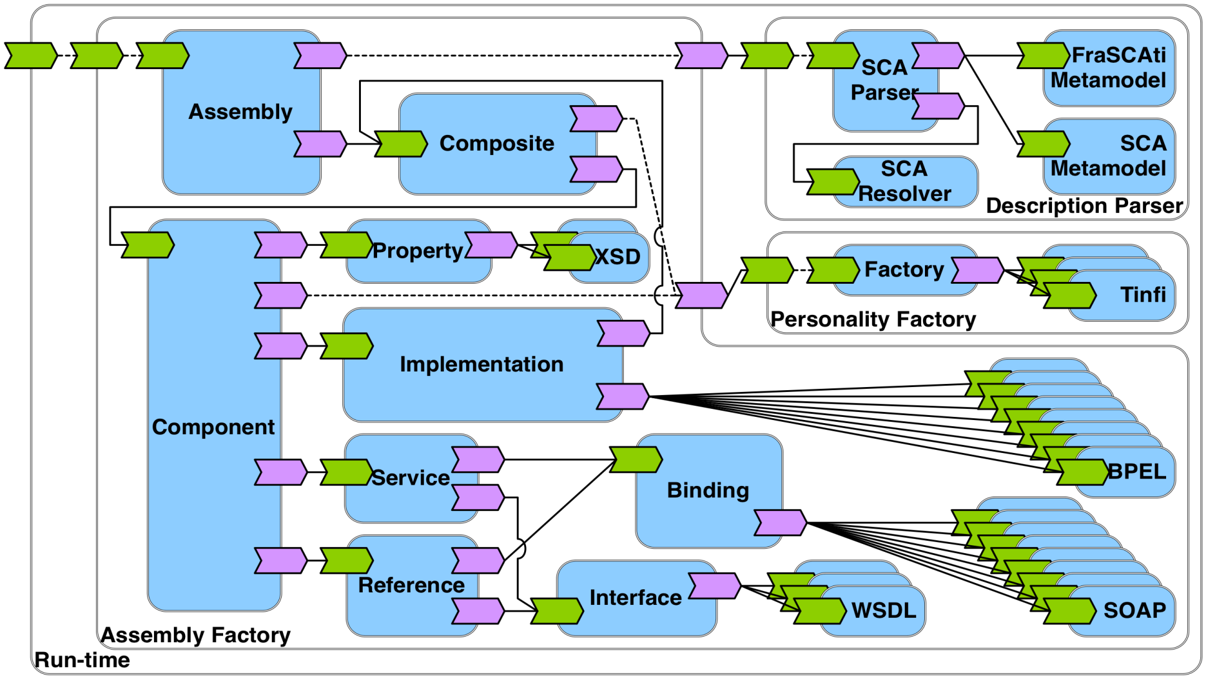
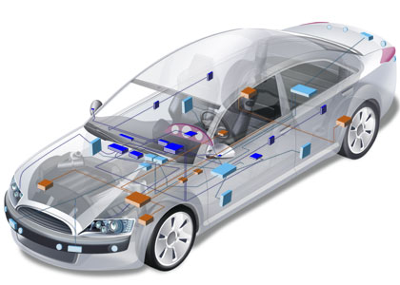
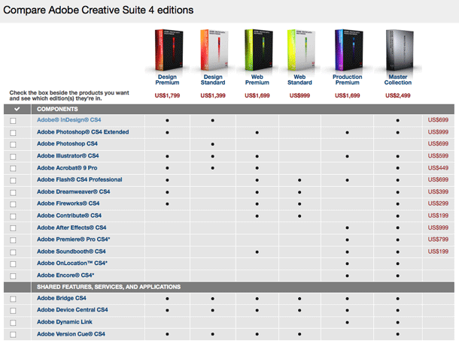
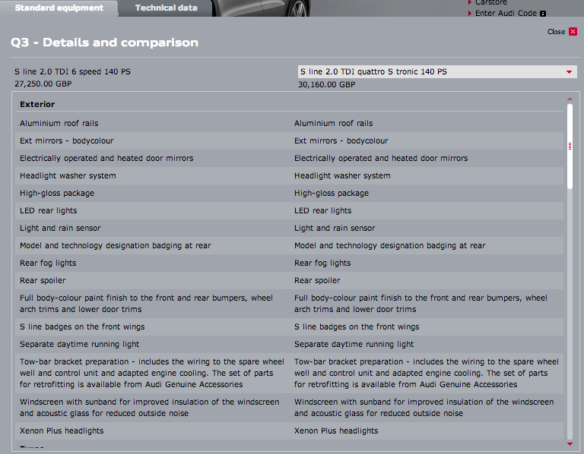
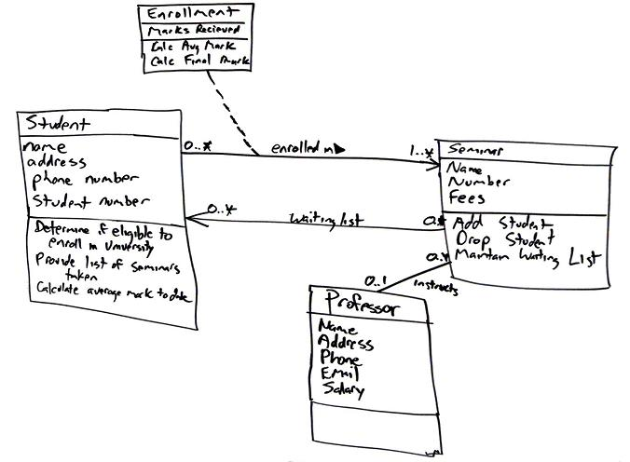
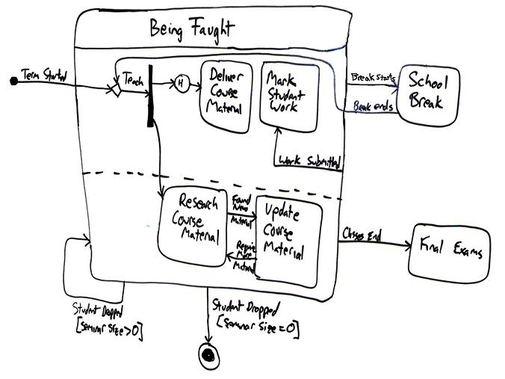
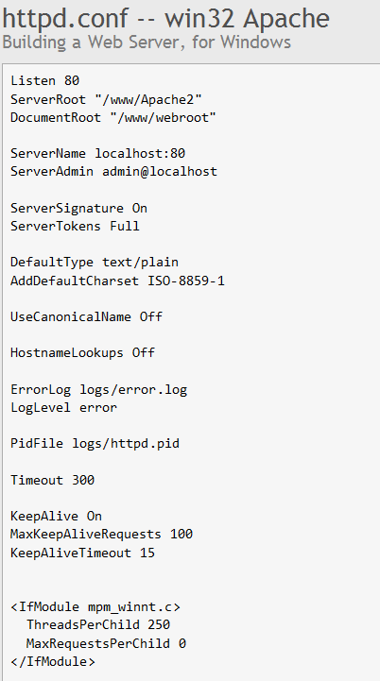
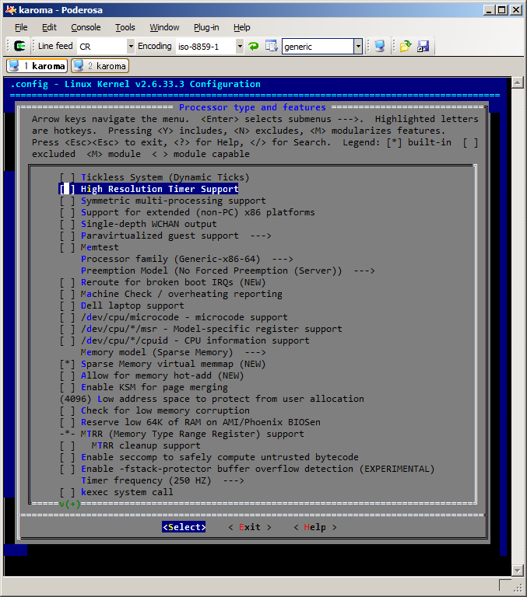
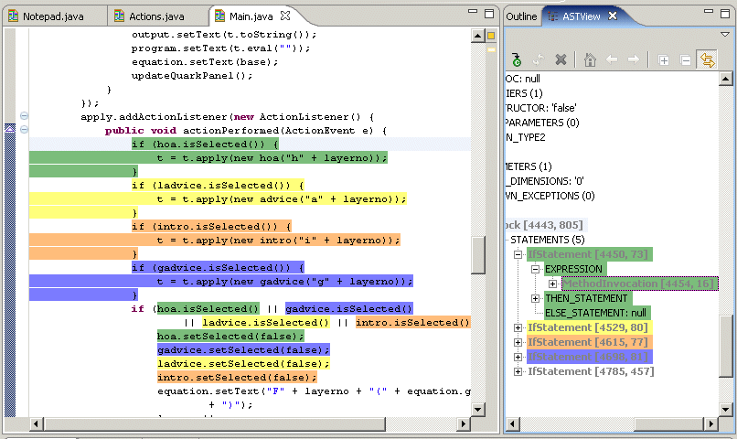
Configurators
Extensible architectures
(eg plugins-based)
System Preferences
External Variability
Internal Variability
Variability @ run.time
Comparison of *
Structural or behavorial
models
Configuration files
Build systems
Source code
14

Slide 15
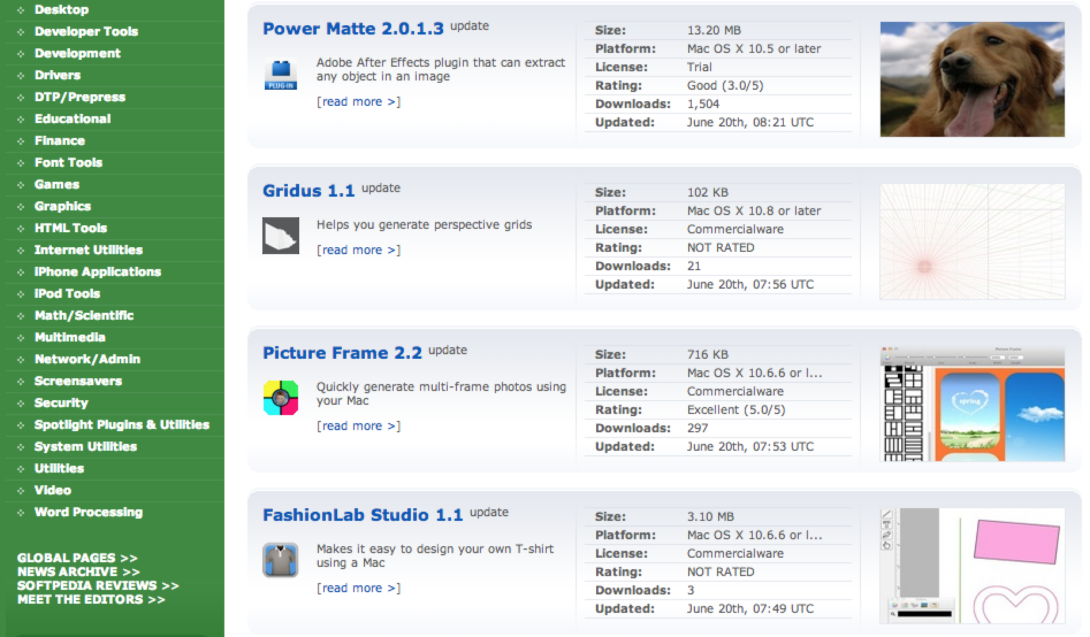
Variability

Slide 16
Variability

Slide 17
Variability

Slide 18
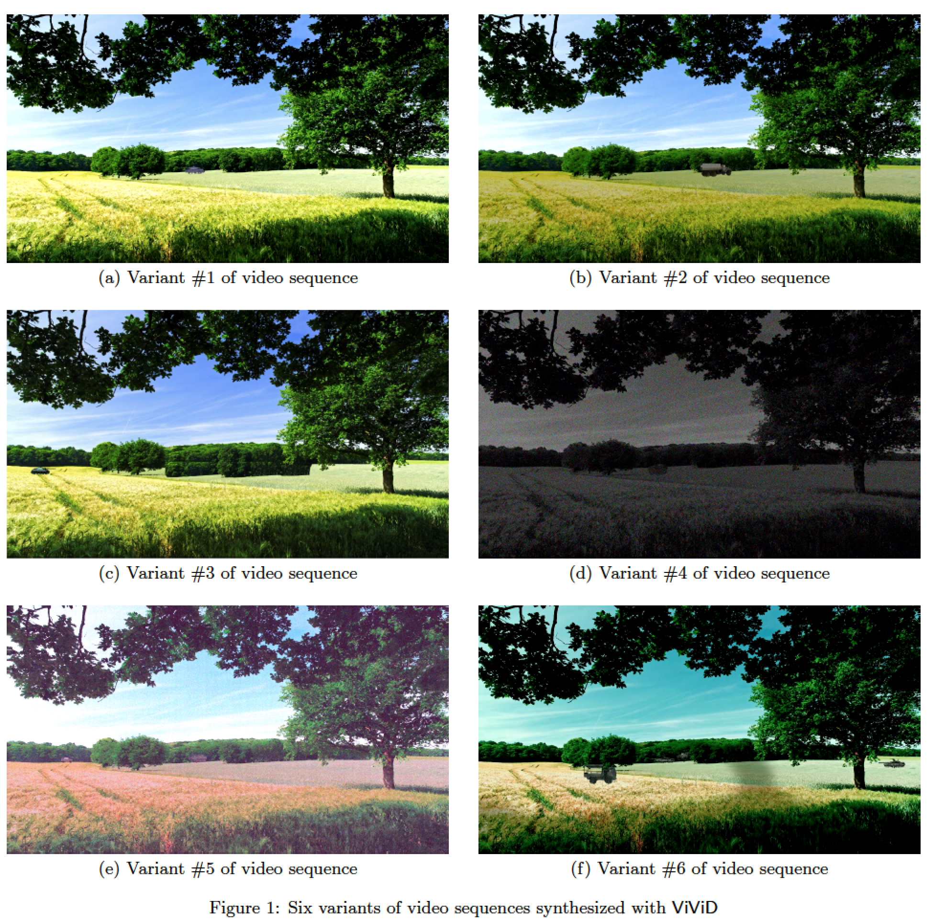

Slide 19
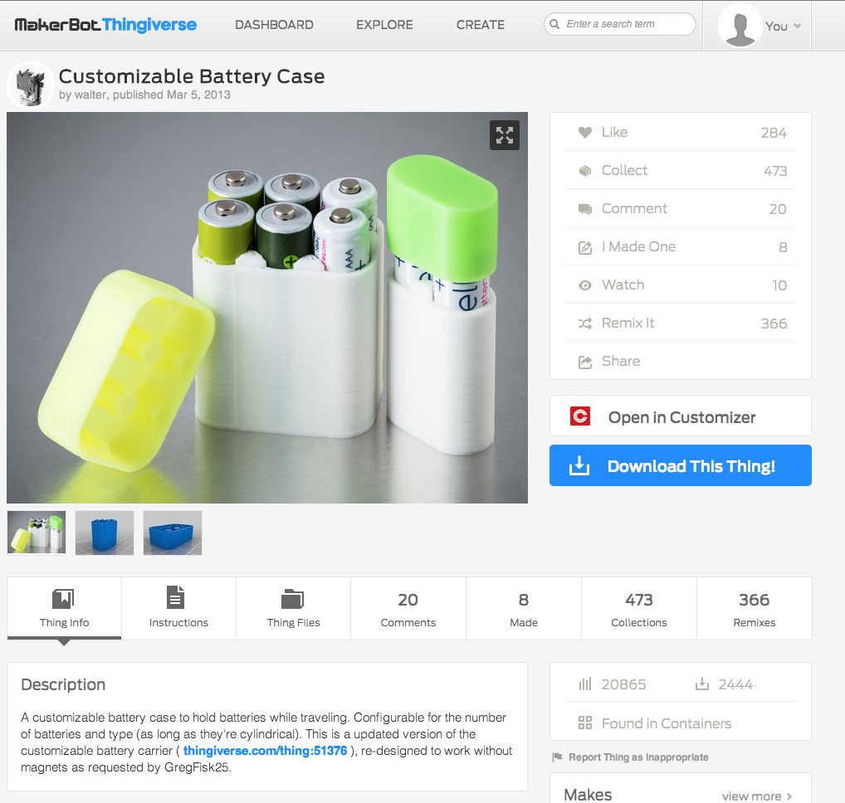
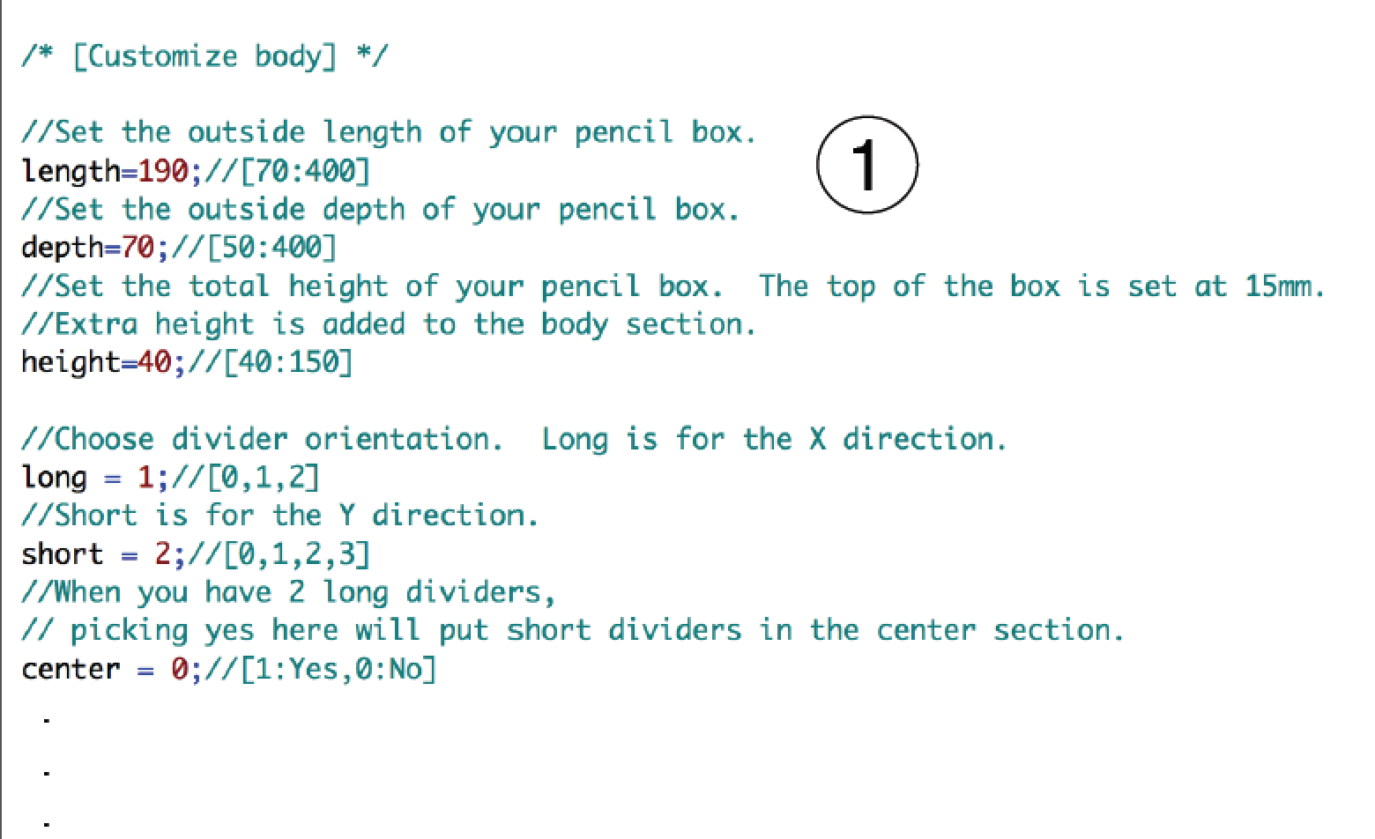
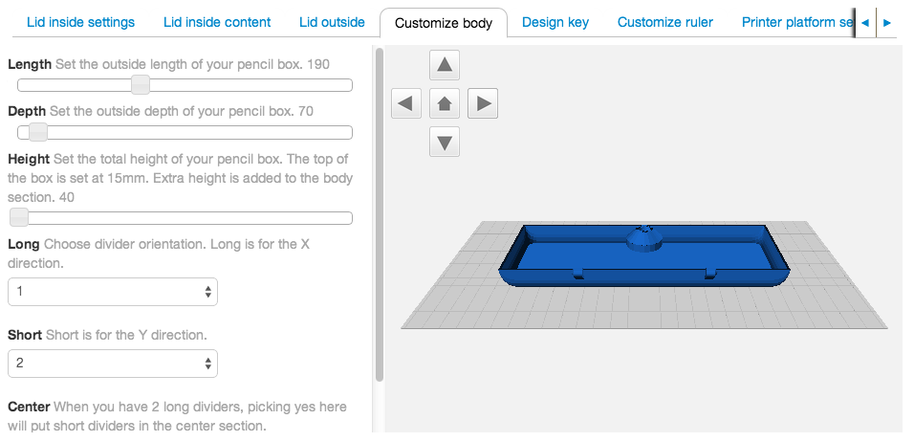

Slide 20
Variability in time vs in space
Variability in Time (releases)
  the existence of different versions of an artifact that are valid at different times
Variability in Space (variants)
  the existence of an artifact in different shapes at the same time

Slide 21
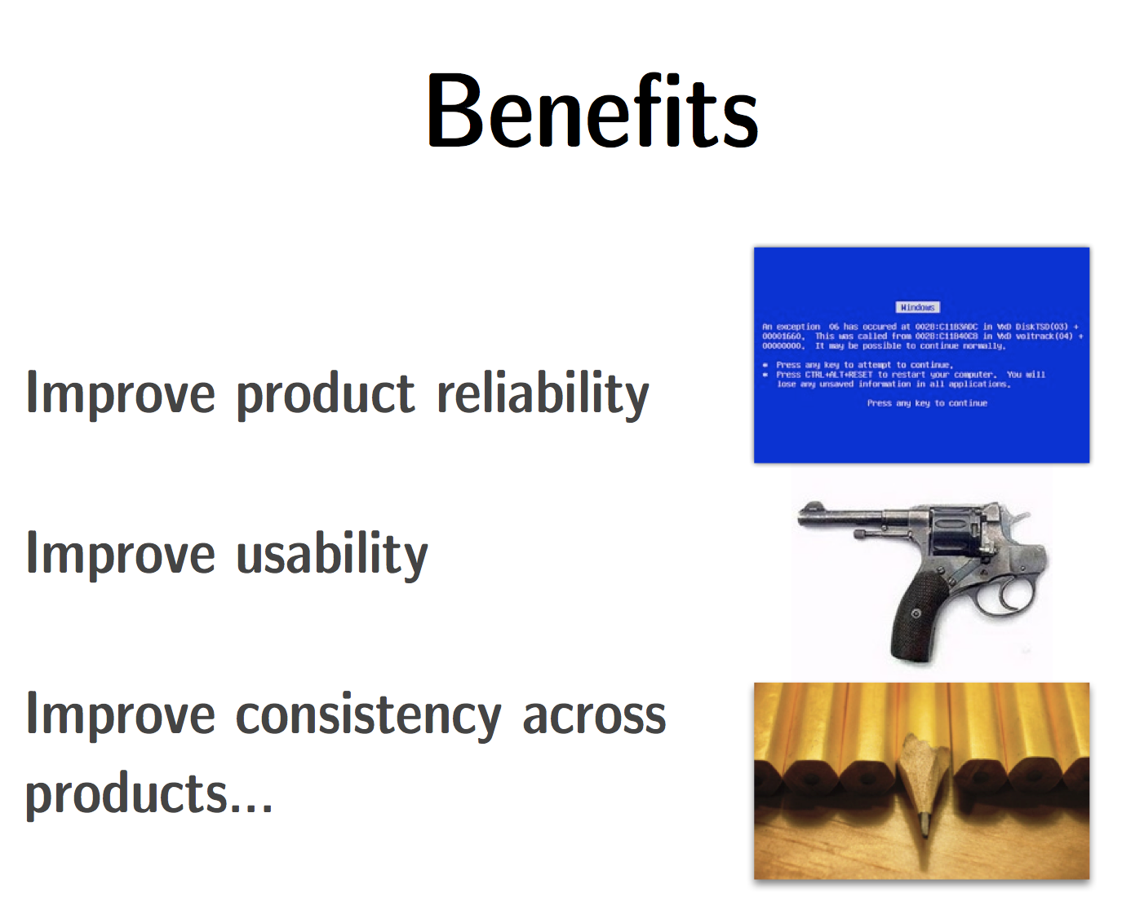

Slide 22
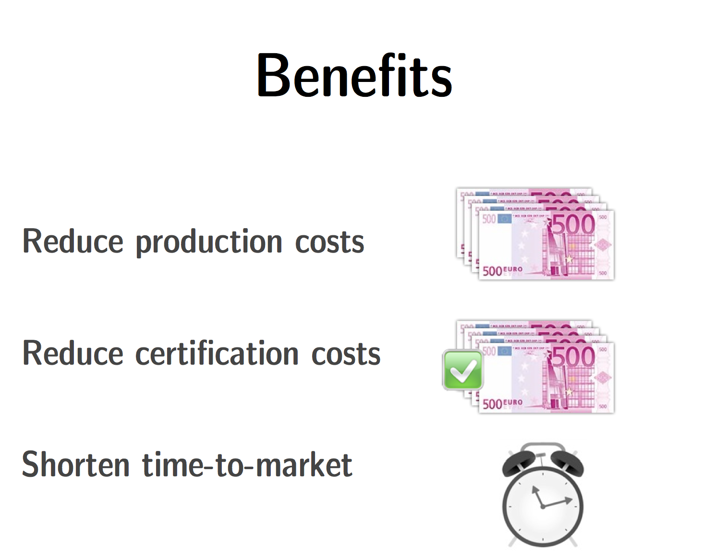

Slide 23
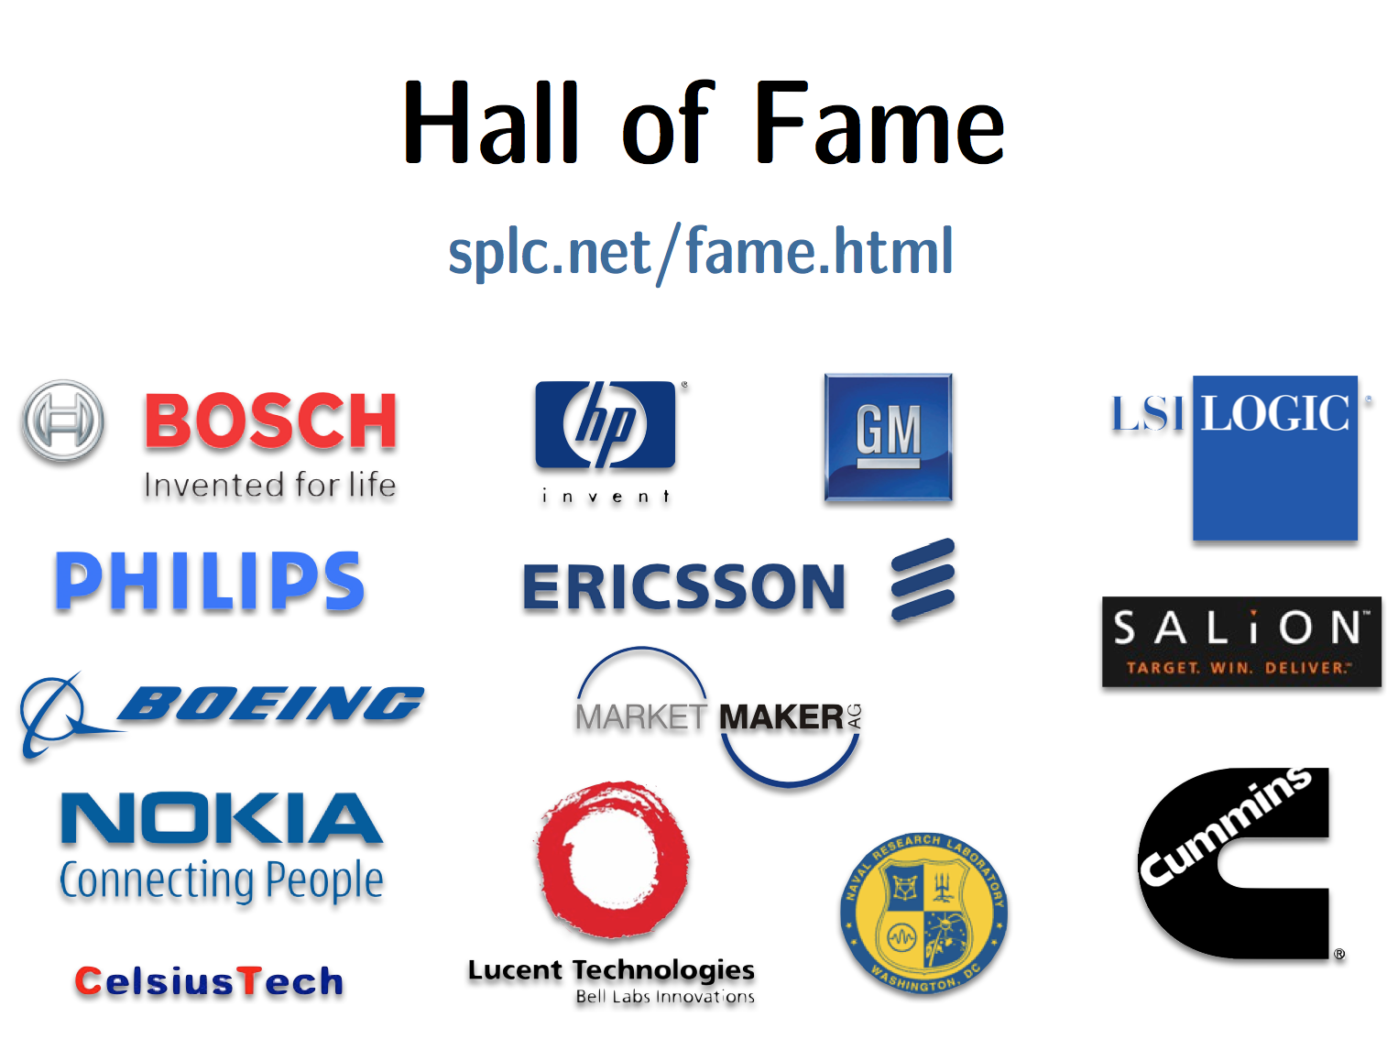

Slide 24
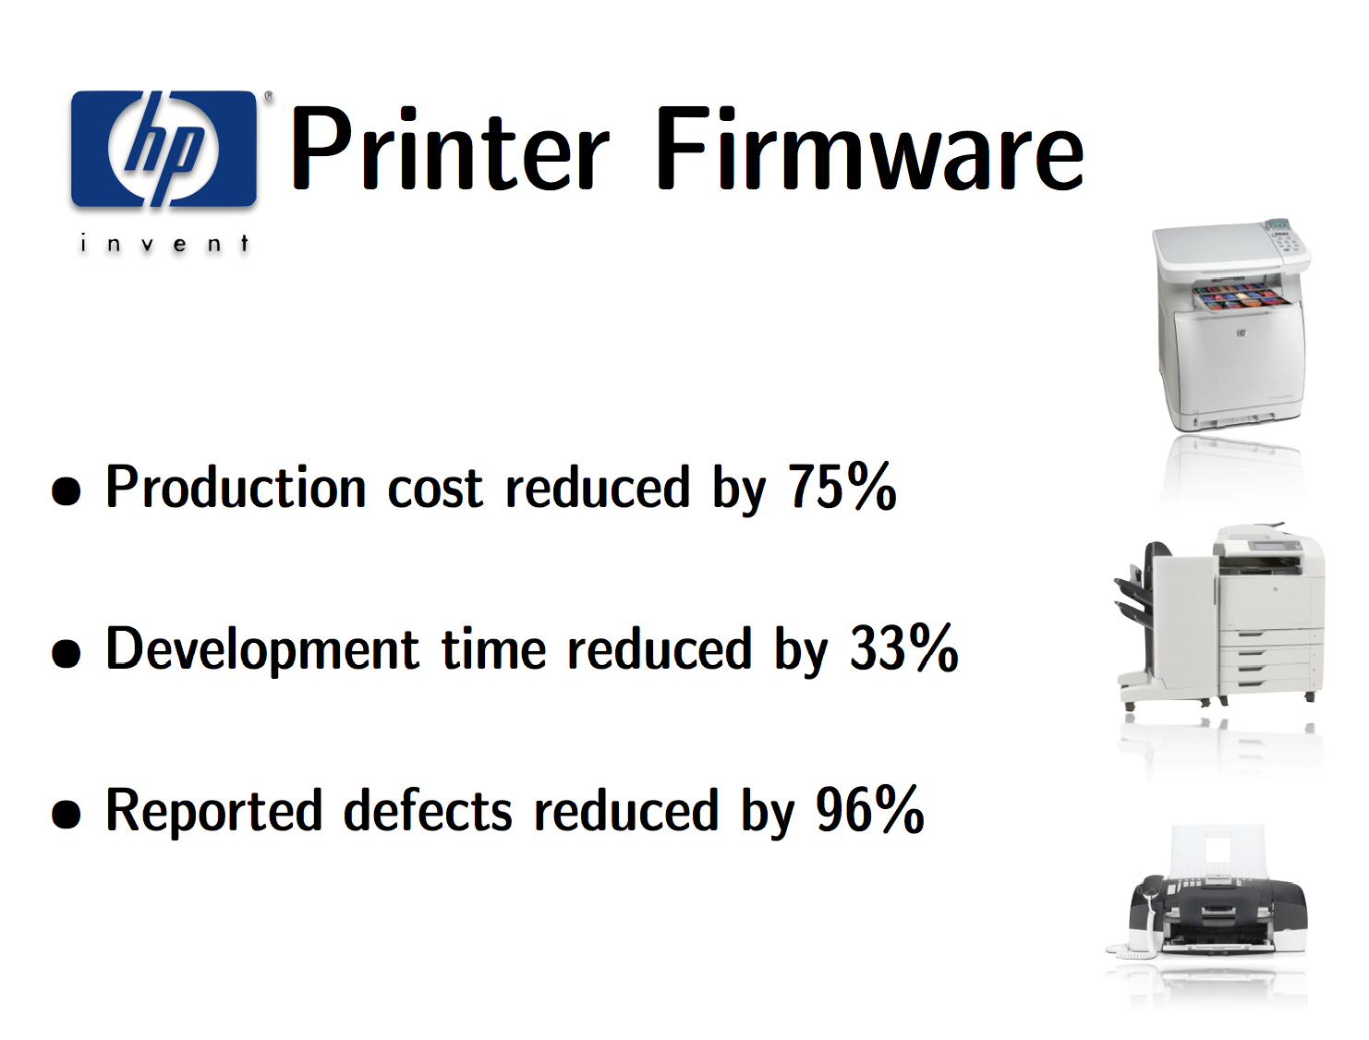

Slide 25
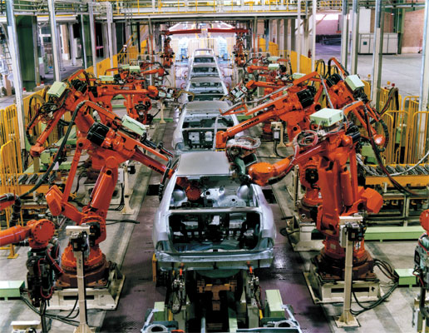
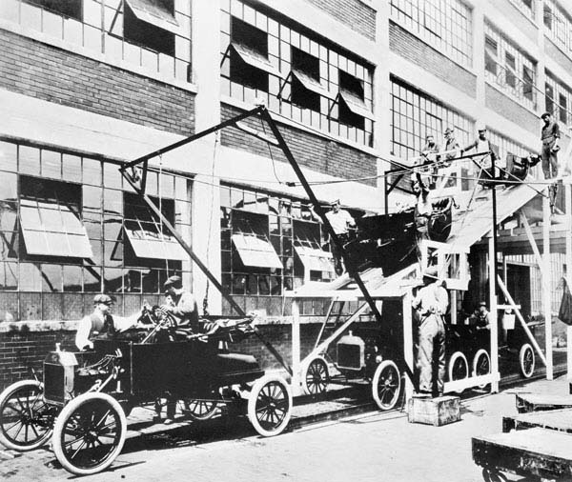

A Bit of History:
Industrial Revolution
1980s
1901
Henry Ford
1698
Thomas Savery
Notes:
Elle désigne le processus historique du XIXe siècle qui se caractérise par le passage d'une société à dominante agraire et artisanale à une société commerciale et industrielle. Cette transformation a affecté profondément l'agriculture, l'économie, la politique, la société et l'environnement du monde contemporain.
la science et la technique font de très grands progrès. On construit d’immenses usines dans lesquelles travaillent des centaines d’ouvriers. Les machines se perfectionnent.
rationalisation du processus productif
Batteuse
Les premiers espaces à s'être industrialisés sont la Grande-Bretagne à la fin du XVIIIe siècle, puis la France au début du XIXe siècle : ce sont les pays de la première vague
Ford: avec le fordisme, introduit le tapis roulant dans les chaînes de montage, pour acheminer les pièces et éviter les déplacements inutiles des ouvriers spécialisés.
nouvelle organisation du travail

Slide 26
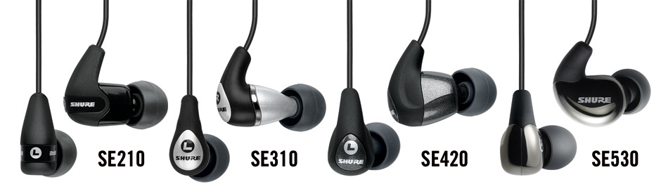
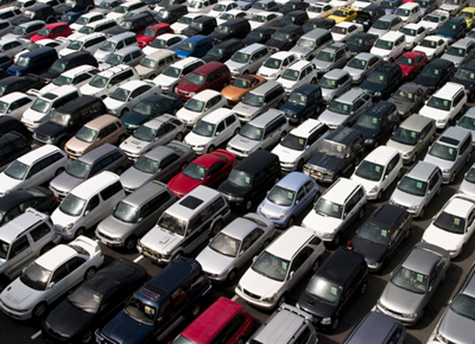
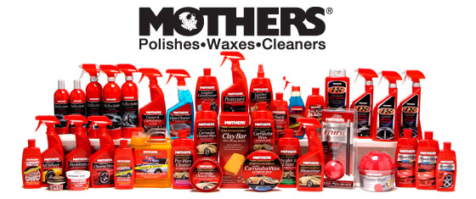
Nowaday: Product Lines Everywhere

Slide 27
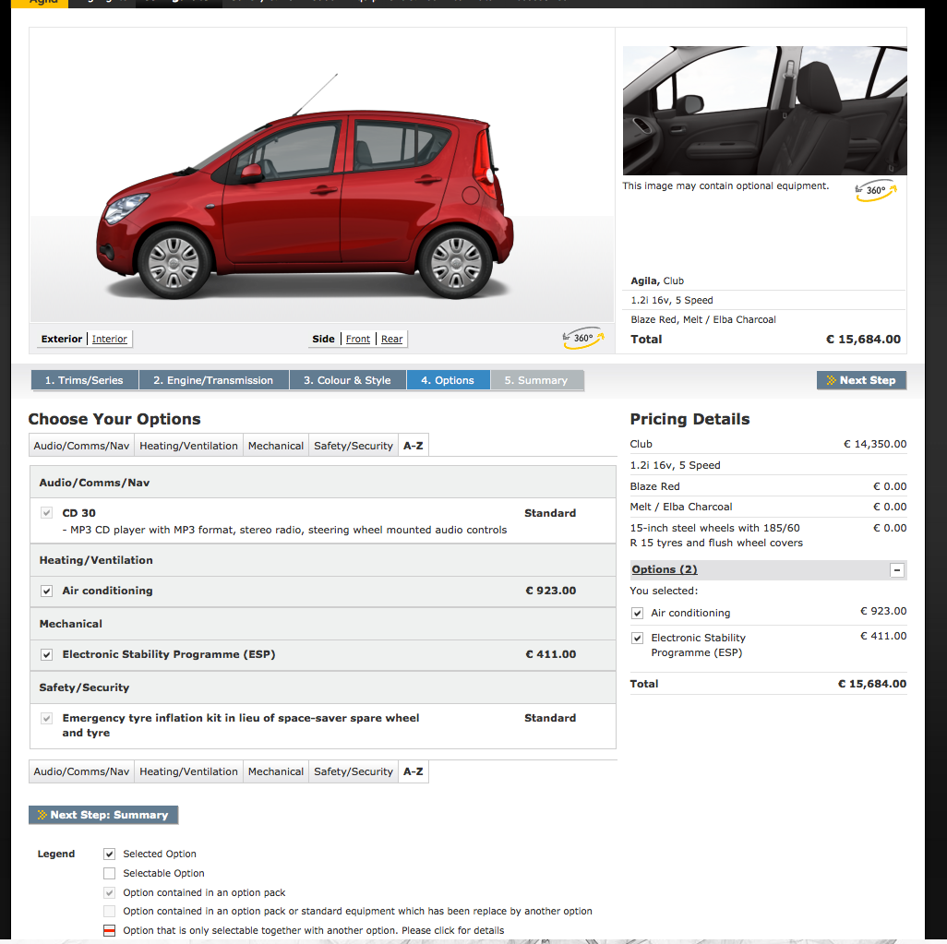
Product Lines of Cars

Slide 28
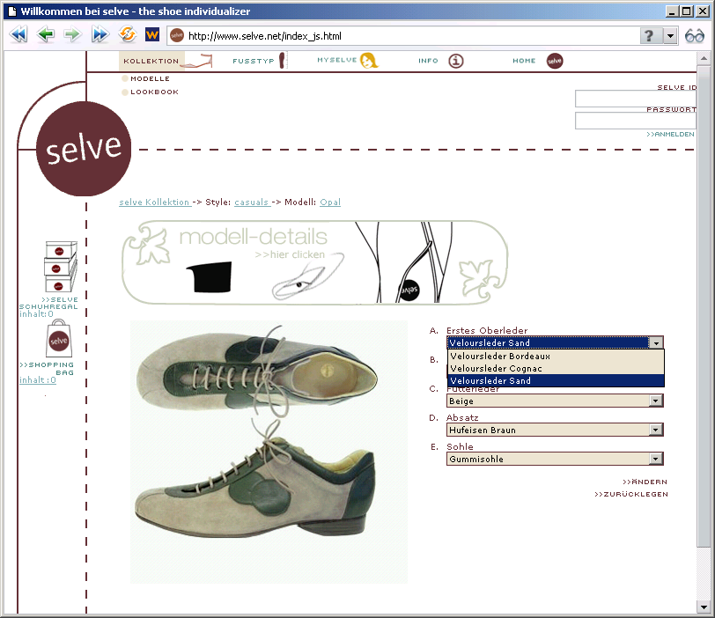

Slide 29
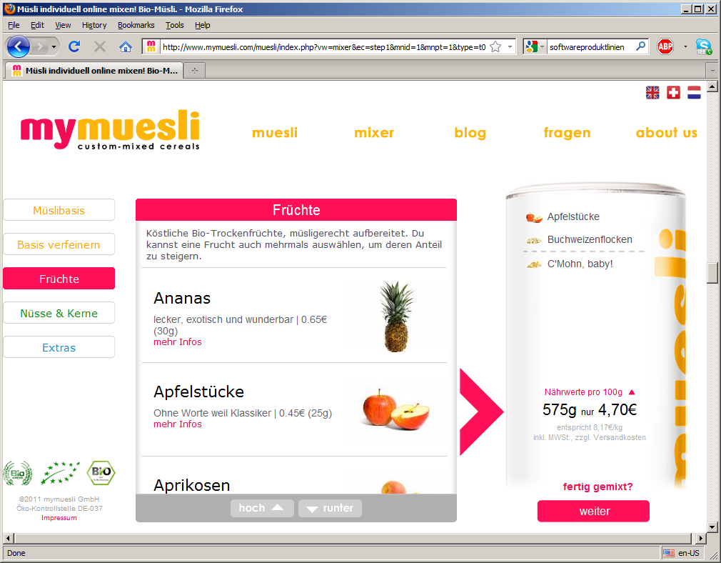

Slide 30
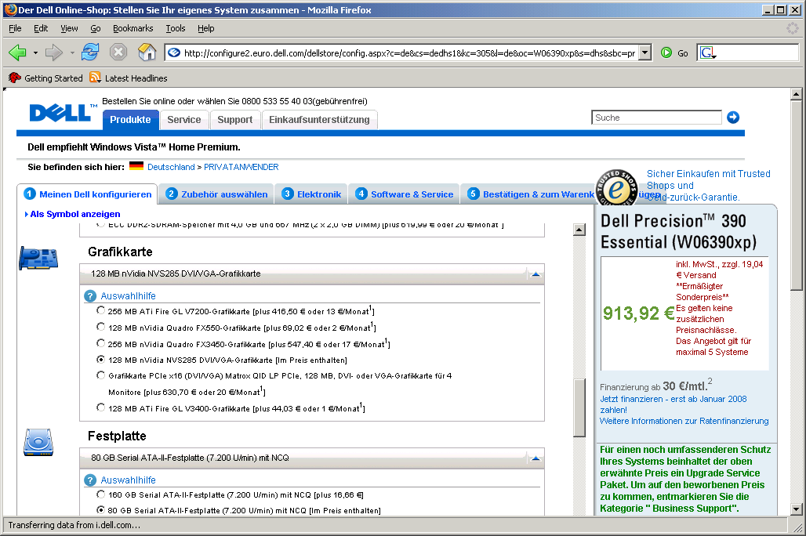

Slide 31
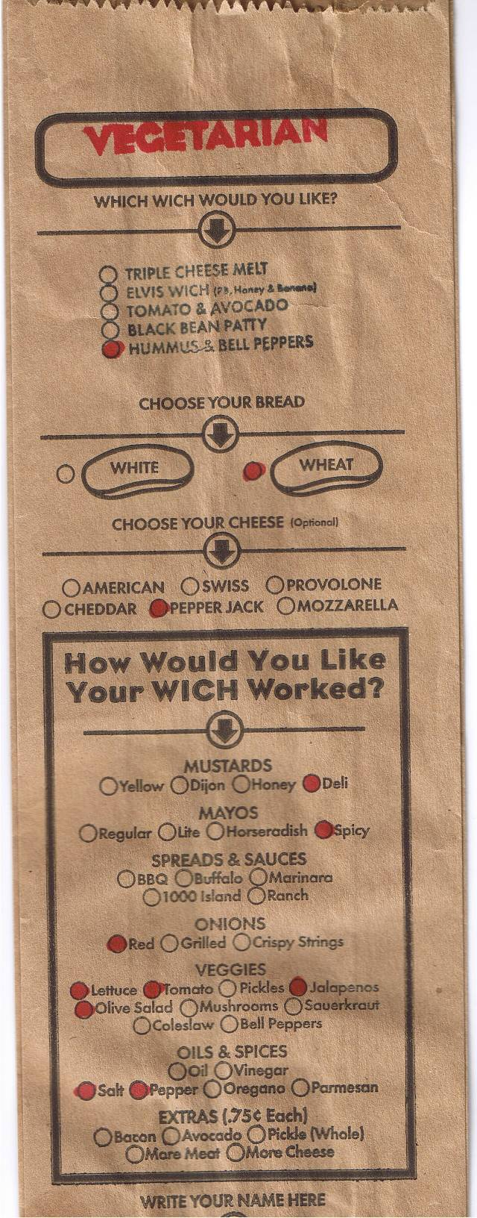
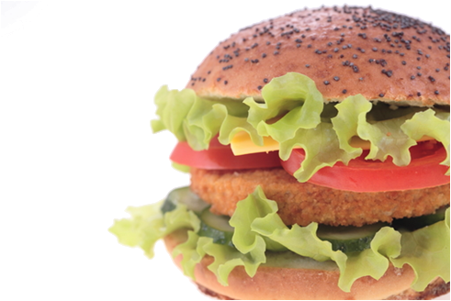
Food? Product lines!

Slide 32
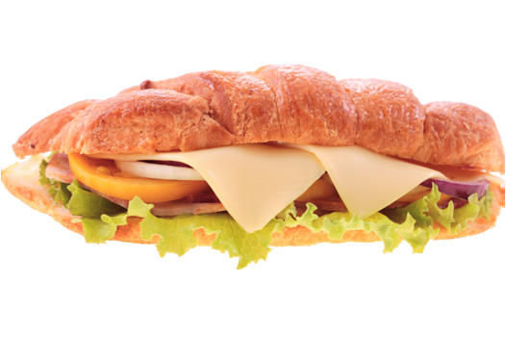
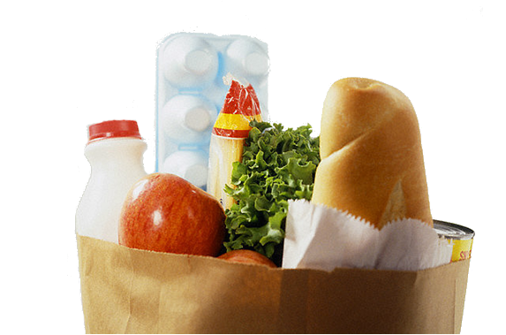
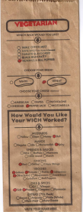
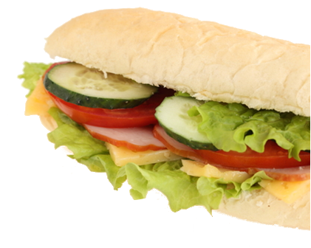


Slide 33

Mass production

Slide 34

What about software?

Slide 35
Product lines of software intensive systems

Slide 36






Software intensive systems
are declined in many variants
Notes:
My research interest is essentially related to software systems and more generally to software intensive systems.
There are many examples of software intensive systems in many domains that populate our daily life (at home, at work, on the road, in the car).
Perhaps the most popular and well-known example of software intensive system is a mobile phone.
If we can send and receive messages, if we can take photos, use the GPS to navigate with a car or perform a bank transaction with a mobile phone, that’s because of the software embedded in the device.
You have a software operating system that manages hardware resources of the mobile phone and you have plenty of software applications that are developed every day.
One major challenge for mobile phone companies like Nokia, Samsung or Apple is to propose to customers all over the word different models of a mobile phone, with different sizes, language support, functionalities, hardware capabilities.
In other words, these companies should be able to develop software not only for one unique model of mobile phone, but rather for different variants of a mobile phone.
Managing the increasing diversity of software intensive systems is obviously a difficult engineering challenge.
A general approach consists in using high level abstractions (models, specifications) to tackle the complexity and diversity of software intensive systems. With a model, software engineers can more easily and efficiently formalize the properties expected from a given system and automatically reason about these properties. These models can also be used to automatically generate software variants at a higher level of abstraction.
Generally, due to the complexity and diversity of software intensive systems, using one specification or one model is neither adequate nor feasible. A multiplicity of models are rather used.
If we consider the software of a mobile phone, we have to specify different concerns: the operating system, the hardware components of the device, the security of the applications, etc.
As we want to handle the diversity of products, a multiplicity of variability models is used.
By software intensive systems, I mean systems that make extensive use of software.
There are plenty of examples, and, for the sake of simplicity, I will take a well known example of a software intensive system, a mobile phone (also called smart phone).
2’30
TODO: need a human + automated + precise
Zoom the upper part and then reduce
Principle widely used in industry
Large product lines of elements
CARS
Software systems
Software Creation and Maintenance
We need formalisms
Complex in size
Nowadays there are a variety of descriptions
Provision of operators
+ merge / slice (notation)
Language
Applications

Slide 37
Software intensive systems
are declined in many variants
Notes:
My research interest is essentially related to software systems and more generally to software intensive systems.
There are many examples of software intensive systems in many domains that populate our daily life (at home, at work, on the road, in the car).
Perhaps the most popular and well-known example of software intensive system is a mobile phone.
If we can send and receive messages, if we can take photos, use the GPS to navigate with a car or perform a bank transaction with a mobile phone, that’s because of the software embedded in the device.
You have a software operating system that manages hardware resources of the mobile phone and you have plenty of software applications that are developed every day.
One major challenge for mobile phone companies like Nokia, Samsung or Apple is to propose to customers all over the word different models of a mobile phone, with different sizes, language support, functionalities, hardware capabilities.
In other words, these companies should be able to develop software not only for one unique model of mobile phone, but rather for different variants of a mobile phone.
Managing the increasing diversity of software intensive systems is obviously a difficult engineering challenge.
A general approach consists in using high level abstractions (models, specifications) to tackle the complexity and diversity of software intensive systems. With a model, software engineers can more easily and efficiently formalize the properties expected from a given system and automatically reason about these properties. These models can also be used to automatically generate software variants at a higher level of abstraction.
Generally, due to the complexity and diversity of software intensive systems, using one specification or one model is neither adequate nor feasible. A multiplicity of models are rather used.
If we consider the software of a mobile phone, we have to specify different concerns: the operating system, the hardware components of the device, the security of the applications, etc.
As we want to handle the diversity of products, a multiplicity of variability models is used.
By software intensive systems, I mean systems that make extensive use of software.
There are plenty of examples, and, for the sake of simplicity, I will take a well known example of a software intensive system, a mobile phone (also called smart phone).
2’30
TODO: need a human + automated + precise
Zoom the upper part and then reduce
Principle widely used in industry
Large product lines of elements
CARS
Software systems
Software Creation and Maintenance
We need formalisms
Complex in size
Nowadays there are a variety of descriptions
Provision of operators
+ merge / slice (notation)
Language
Applications

Slide 38




Software Product Lines

Slide 39

Car

Slide 40



Database
Engine

Slide 41


Printer Firmware

Slide 42





Linux
Kernel

Slide 43

Linux-Kernel

Slide 44

Features in Microsoft Office

Slide 45
Bref

Slide 46


Slide 47

Online Generator

Slide 48

Variant

Slide 49


Quizz Time
e9a8d603

Slide 50
Quizz Time
e9a8d603
Give three examples of software product lines
(also called configurable systems or variability-intensive systems)

Slide 51
Variability
“the ability of a system to be efficiently extended, changed, customized or configured for use in a particular context”
Mikael Svahnberg, Jilles van Gurp, and Jan Bosch (2005)

Slide 52

Variability = Complexity

Slide 53

33 features
optional, independent
a unique variant for every
person on this planet

Slide 54

320 features
more variants than estimated
atoms in the universe
optional, independent

Slide 55


10000
2000 features
features

Slide 56

Automation?
Avoid solving the same problem!
2, 3…n times

Slide 57

Correctness?

Slide 58

Maintenance?
Comprehension?

Slide 59

Checking Products
2000 Features
100 Printers
30 New Printers per Year
Printer Firmware

Slide 60


Checking Products
8000 Features
? Products
Linux
Kernel

Slide 61
The development of a
family of software systems
differs from the development of
a single software system

Slide 62


Slide 63
« The development of a
family of software systems
differs from the development of
a single software system »
Reuse
Customization
Automation
Commonality
Variability

Slide 64

Assembly Line
and
Mass Customization
Notes:
Let us take again a simple but intuitive example.
In the automotive industry, assembly lines are used to massively produce cars, much faster than with handcrafting-type methods.
Mass customization is achieved to offer a variety of car models to various customers that can choose between different sizes, types, colors, qualities or prices.
Basically the automotive industry designs, develops and sells “product lines”.

Slide 65

Reuse
and
Mass Customization

Slide 66

Starting from scratch?

Slide 67

You cannot start from scratch

Slide 68








“a set of software- intensive systems that share a common, managed set of features satisfying the specific needs of a particular market segment or mission and that are developed from a common set of core assets in a prescribed way” [Clements et al., 2001]
Software
Product Lines
Notes:
By analogy with the product lines of automotive industry, there are software product lines
TODO: change the pictures (VS + Medical imaging domain)
State that “mobile phone” is just an example
Software systems.

Slide 69


Slide 70

Variability Realization Model (VRM)
Variability Abstraction Model (VAM)
Domain Artefacts (e.g., models)
✓
✓
Configuration
(resolution model)
Software Generator
(derivation engine)

Slide 71

Mapping: an example
class Graph {
Vector nv = new Vector(); Vector ev = new Vector();
Edge add(Node n, Node m) {
Edge e = new Edge(n, m);
nv.add(n); nv.add(m); ev.add(e);
e.weight = new Weight();
return e;
}
Edge add(Node n, Node m, Weight w)
Edge e = new Edge(n, m);
nv.add(n); nv.add(m); ev.add(e);
e.weight = w; return e;
}
void print() {
for(int i = 0; i < ev.size(); i++) {
((Edge)ev.get(i)).print();
}
}
}
class Graph {
Vector nv = new Vector(); Vector ev = new Vector();
Edge add(Node n, Node m) {
Edge e = new Edge(n, m);
nv.add(n); nv.add(m); ev.add(e);
e.weight = new Weight();
return e;
}
Edge add(Node n, Node m, Weight w)
Edge e = new Edge(n, m);
nv.add(n); nv.add(m); ev.add(e);
e.weight = w; return e;
}
void print() {
for(int i = 0; i < ev.size(); i++) {
((Edge)ev.get(i)).print();
}
}
}
class Node {
int id = 0;
Color color = new Color();
void print() {
Color.setDisplayColor(color);
System.out.print(id);
}
}
class Node {
int id = 0;
Color color = new Color();
void print() {
Color.setDisplayColor(color);
System.out.print(id);
}
}
class Edge {
Node a, b;
Color color = new Color();
Weight weight = new Weight();
Edge(Node _a, Node _b) { a = _a; b = _b; }
void print() {
Color.setDisplayColor(color);
a.print(); b.print();
weight.print();
}
}
class Edge {
Node a, b;
Color color = new Color();
Weight weight = new Weight();
Edge(Node _a, Node _b) { a = _a; b = _b; }
void print() {
Color.setDisplayColor(color);
a.print(); b.print();
weight.print();
}
}
class Edge {
Node a, b;
Color color = new Color();
Weight weight;
Edge(Node _a, Node _b) { a = _a; b = _b; }
void print() {
Color.setDisplayColor(color);
a.print(); b.print();
weight.print();
}
}
class Color {
static void setDisplayColor(Color c) { ... }
}
class Weight { void print() { ... } }

Slide 72
class Graph {
Vector nv = new Vector(); Vector ev = new Vector();
Edge add(Node n, Node m) {
Edge e = new Edge(n, m);
nv.add(n); nv.add(m); ev.add(e);
/*if[WEIGHT]*/
e.weight = new Weight();
/*end[WEIGHT]*/
return e;
}
/*if[WEIGHT]*/
Edge add(Node n, Node m, Weight w)
Edge e = new Edge(n, m);
nv.add(n); nv.add(m); ev.add(e);
e.weight = w; return e;
}
/*end[WEIGHT]*/
void print() {
for(int i = 0; i < ev.size(); i++) {
((Edge)ev.get(i)).print();
}
}
}
class Edge {
Node a, b;
/*if[COLOR]*/
Color color = new Color();
/*end[COLOR]*/
/*if[WEIGHT]*/
Weight weight;
/*end[WEIGHT]*/
Edge(Node _a, Node _b) { a = _a; b = _b; }
void print() {
/*if[COLOR]*/
Color.setDisplayColor(color);
/*end[COLOR]*/
a.print(); b.print();
/*if[WEIGHT]*/
weight.print();
/*end[WEIGHT]*/
}
}
/*if[COLOR]*/
class Color {
static void setDisplayColor(Color c) { ... }
}
/*end[COLOR]*/
/*if[WEIGHT]*/
class Weight { void print() { ... } }
/*end[WEIGHT]*/
class Node {
int id = 0;
/*if[COLOR]*/
Color color = new Color();
/*end[COLOR]*/
void print() {
/*if[COLOR]*/
Color.setDisplayColor(color);
/*end[COLOR]*/
System.out.print(id);
}
}

Slide 73
✓
class Graph {
Vector nv = new Vector(); Vector ev = new Vector();
Edge add(Node n, Node m) {
Edge e = new Edge(n, m);
nv.add(n); nv.add(m); ev.add(e);
e.weight = new Weight();
return e;
}
Edge add(Node n, Node m, Weight w)
Edge e = new Edge(n, m);
nv.add(n); nv.add(m); ev.add(e);
e.weight = w; return e;
}
void print() {
for(int i = 0; i < ev.size(); i++) {
((Edge)ev.get(i)).print();
}
}
}
class Edge {
Node a, b;
Weight weight;
Edge(Node _a, Node _b) { a = _a; b = _b; }
void print() {
a.print(); b.print();
weight.print();
}
}
class Node {
int id = 0;
void print() {
System.out.print(id);
}
}
class Weight { void print() { ... } }

Slide 74
✓
class Graph {
Vector nv = new Vector(); Vector ev = new Vector();
Edge add(Node n, Node m) {
Edge e = new Edge(n, m);
nv.add(n); nv.add(m); ev.add(e);
return e;
}
void print() {
for(int i = 0; i < ev.size(); i++) {
((Edge)ev.get(i)).print();
}
}
}
class Edge {
Node a, b;
Color color = new Color();
Edge(Node _a, Node _b) { a = _a; b = _b; }
void print() {
Color.setDisplayColor(color);
a.print(); b.print();
}
}
class Color {
static void setDisplayColor(Color c) { ... }
}
class Node {
int id = 0;
Color color = new Color();
void print() {
Color.setDisplayColor(color);
System.out.print(id);
}
}

Slide 75
Domain
Engineering
Domain/Variability Model
Domain Artefacts
Application
Engineering
✓
✓
✓
Configuration
Software Generator
« the investments required to develop the reusable artifacts during domain engineering, are outweighed by the benefits of deriving the individual products during application engineering »
Jan Bosch et al. (2004)

Slide 76
Software Product Line and Variability Engineering
A revisit of your cursus

Slide 77
What is new?
Family vs single systems
Focus on reuse
Domain engineering
Factoring out commonality
Managing variability
Notes:
Focus sur le scope de la thèse, et ne pas dire “on ne va pas parler de….”

Slide 78
« variability »
Is it really new?
Notes:
Focus sur le scope de la thèse, et ne pas dire “on ne va pas parler de….”

Slide 79

Parameter

Slide 80

Parameter –i in grep

Slide 81
Global configuration
class Config {
public static boolean isLogging = false;
public static boolean isWindows = false;
public static boolean isLinux = true;
}
class Main {
public void foo() {
if (isLogging)
log(„running foo()“);
if (isWindows)
callWindowsMethod();
else if (isLinux)
callLinuxMethod();
else
throw RuntimeException();
}

Slide 82
Configuration

Slide 83
Conditional compilation
#ifdef (Berkeley DB)
static int __rep_queue_filedone(dbenv, rep, rfp)
DB_ENV *dbenv;
REP *rep;
__rep_fileinfo_args *rfp; {
#ifndef HAVE_QUEUE
COMPQUIET(rep, NULL);
COMPQUIET(rfp, NULL);
return (__db_no_queue_am(dbenv));
#else
db_pgno_t first, last;
u_int32_t flags;
int empty, ret, t_ret;
#ifdef DIAGNOSTIC
DB_MSGBUF mb;
#endif
// over 100 lines of additional code
}
#endif

Slide 84
Intentional Code Cloning
~ Copy & Paste

Slide 85
Code Cloning (example, Linux driver)
cyberstorm.c
….
static void dma_dump_state(struct NCR_ESP *esp)
{
ESPLOG(("esp%d: dma -- cond_reg<%02x>\n",
esp->esp_id, ((struct cyber_dma_registers *)
(esp->dregs))->cond_reg));
ESPLOG(("intreq:<%04x>, intena:<%04x>\n",
custom.intreqr, custom.intenar));
}
static void dma_init_read(struct NCR_ESP *esp, __u32 addr, int length)
{
struct cyber_dma_registers *dregs =
(struct cyber_dma_registers *) esp->dregs;
cache_clear(addr, length);
addr &= ~(1);
dregs->dma_addr0 = (addr >> 24) & 0xff;
dregs->dma_addr1 = (addr >> 16) & 0xff;
dregs->dma_addr2 = (addr >> 8) & 0xff;
dregs->dma_addr3 = (addr ) & 0xff;
ctrl_data &= ~(CYBER_DMA_WRITE);
…….
cyberstormII.c
….
static void dma_dump_state(struct NCR_ESP *esp)
{
ESPLOG(("esp%d: dma -- cond_reg<%02x>\n",
esp->esp_id, ((struct cyberII_dma_registers *)
(esp->dregs))->cond_reg));
ESPLOG(("intreq:<%04x>, intena:<%04x>\n",
custom.intreqr, custom.intenar));
}
static void dma_init_read(struct NCR_ESP *esp, __u32 addr, int length)
{
struct cyberII_dma_registers *dregs =
(struct cyberII_dma_registers *) esp->dregs;
cache_clear(addr, length);
addr &= ~(1);
dregs->dma_addr0 = (addr >> 24) & 0xff;
dregs->dma_addr1 = (addr >> 16) & 0xff;
dregs->dma_addr2 = (addr >> 8) & 0xff;
dregs->dma_addr3 = (addr ) & 0xff;
}
……...

Slide 86


Slide 87


Slide 88


Slide 89
Inheritance (OOP)
Base Class encapsulate commonalities
Derive classes specialize peculiarities

Slide 90
Generic Programming
C++ template
template <typename T>
T max(T x, T y)
{
return x < y ? y : x;
}
Generics in Java
public interface List<E> {
void add(E x);
Iterator<E> iterator();
}
public interface Iterator<E> {
E next();
boolean hasNext();
}

Slide 91
Design Patterns
  Template Method
  Factory
  Strategy
  Decorator
  ....

Slide 92

Template Method
Notes:
A template method defines the program skeleton of an algorithm. One or more of the algorithm steps can be overridden by subclasses to allow differing behaviors while ensuring that the overarching algorithm is still followed.
In object-oriented programming, first a class is created that provides the basic steps of an algorithm design. These steps are implemented using abstract methods. Later on, subclasses change the abstract methods to implement real actions. Thus the general algorithm is saved in one place but the concrete steps may be changed by the subclasses.

Slide 93


Slide 94
API
Framework

Slide 95
Plugin-based systems

Slide 96
(Active) Annotations can have parameters

Slide 97
Metamodeling and Domain-Specific Languages

Slide 98
Commonalities
TP3
Model-to-Model
Pivot
MM
Another DSL
TP3
TP4
UI
model
Questionnaire.xtext
Model-to-Text
TP2
Generator
TP5

Slide 100

Unused flexibility

Slide 101

Illegal variant

Slide 102

Domain Design
Czarnecki et al. (GPCE’05)

Slide 103
Feature Models

Slide 104
Modeling variability
is crucial
Variability Model
Domain Artefacts (e.g., source code)
✓
✓
Configuration
Software Generator

Slide 105
Unused flexibility

Slide 106
Illegal variant

Slide 107


Feature Model
Communicative
Analytic
Generative

Slide 108


Slide 109



excludes

Slide 110


Slide 111

Feature Models
Notes:
Or-group
An excerpt of the medical imaging analysis domain…… (justify)
Ref sur les feature models
A feature model is a hierarchy of features with variabilty
The primary purpose of the hierarchy is to organize features into multiple levels of increasing detail
Variability deﬁnes what the allowed combinations of features are.
Variability in a feature model is expressed through different mechanisms.
describes a set of valid feature combinations.

Slide 112
Feature Models (Background)
Hierarchy: rooted tree
Variability:
mandatory,
optional,
Groups: exclusive or inclusive features
Cross-tree constraints
Notes:
Or-group
An excerpt of the medical imaging analysis domain…… (justify)
Ref sur les feature models
A feature model is a hierarchy of features with variabilty
The primary purpose of the hierarchy is to organize features into multiple levels of increasing detail
Variability deﬁnes what the allowed combinations of features are.
Variability in a feature model is expressed through different mechanisms.
describes a set of valid feature combinations.

Slide 113

✓
Hierarchy + Variability
=
set of valid configurations
configuration = set of features selected
{CarEquipment, Comfort, DrivingAndSafety, Healthing, AirConditioning, FrontFogLights}
Notes:
An excerpt of the medical imaging analysis domain…… (justify)
Ref sur les feature models
A feature model is a hierarchy of features with variabilty
The primary purpose of the hierarchy is to organize features into multiple levels of increasing detail
Variability deﬁnes what the allowed combinations of features are.
Variability in a feature model is expressed through different mechanisms.
describes a set of valid feature combinations.

Slide 114

✓
Hierarchy + Variability
=
set of valid configurations
configuration = set of features selected
{CarEquipment, Comfort, DrivingAndSafety, Healthing, AirConditioning}
Notes:
An excerpt of the medical imaging analysis domain…… (justify)
Ref sur les feature models
A feature model is a hierarchy of features with variabilty
The primary purpose of the hierarchy is to organize features into multiple levels of increasing detail
Variability deﬁnes what the allowed combinations of features are.
Variability in a feature model is expressed through different mechanisms.
describes a set of valid feature combinations.

Slide 115

✓
✓
✓
✓
✓
✓
✓
Hierarchy + Variability
=
set of valid configurations
configuration = set of features selected
{CarEquipment, Comfort, DrivingAndSafety, Healthing, AirConditioning,
AutomaticHeadLights}
Notes:
An excerpt of the medical imaging analysis domain…… (justify)
Ref sur les feature models
A feature model is a hierarchy of features with variabilty
The primary purpose of the hierarchy is to organize features into multiple levels of increasing detail
Variability deﬁnes what the allowed combinations of features are.
Variability in a feature model is expressed through different mechanisms.
describes a set of valid feature combinations.

Slide 116
✓
✓
Hierarchy + Variability
=
set of valid configurations
{AirConditioning, FrontFogLights}
{AutomaticHeadLights, AirConditioning, FrontFogLights}
{AutomaticHeadLights, FrontFogLights, AirConditioningFrontAndRear}
{AirConditioningFrontAndRear}
{AirConditioning}
{AirConditioningFrontAndRear, FrontFogLights}
{CarEquipment, Comfort, DrivingAndSafety, Healthing}
X
Notes:
An excerpt of the medical imaging analysis domain…… (justify)
Ref sur les feature models
A feature model is a hierarchy of features with variabilty
The primary purpose of the hierarchy is to organize features into multiple levels of increasing detail
Variability deﬁnes what the allowed combinations of features are.
Variability in a feature model is expressed through different mechanisms.
describes a set of valid feature combinations.

Slide 117

Feature Models
Notes:
Or-group
An excerpt of the medical imaging analysis domain…… (justify)
Ref sur les feature models
A feature model is a hierarchy of features with variabilty
The primary purpose of the hierarchy is to organize features into multiple levels of increasing detail
Variability deﬁnes what the allowed combinations of features are.
Variability in a feature model is expressed through different mechanisms.
describes a set of valid feature combinations.

Slide 118


Slide 119


Slide 120
Bref
as a product line

Slide 122
How MDE (IDM) can help
Software Product Line Engineering

Slide 123
Generative approach
Programming the generation of programs
    Very old practice
    Metaprogramming: generative language and target language are the same
      Reflection capabilities
Generalization of this idea:
  from a specification written in one or more textual or graphical domain-specific languages
  you generate customized variants

Slide 124
Modeling and implementing system families such that a desired system can be automatically generated from a specification written in one or more textual or graphical domain-specific languages.
Models
And
Languages

Slide 125




Models
And
Languages

Slide 126

[Czarnecki and Eisenecker 2000]

Slide 127

[Czarnecki, PhD thesis]

Slide 128
Developing Product Lines
Metamodels, DSLs, and Transformations to the rescue
Domain Engineering
  Domain Models
  Level of abstraction
  Domain-specific modeling languages
    (visual or textual) syntacs, precise semantics
    analyzed (verification)
  Traceability between the artefacts
Application Engineering
  Model transformations (automation)
Reduce the gap

Slide 129
Summary
Software product line engineering
  Mass customization
  Family of software intensive systems
  Systematic reuse
  Domain engineering
  Variability management
Variability everywhere
  Applied and applicable to many industries and domains
Modeling and implementing variability: an overview

